Slide 1

Area, Volume & Mensuration

Slide 2
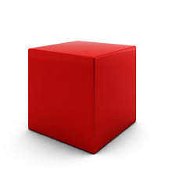
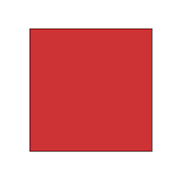
Concept

Slide 3

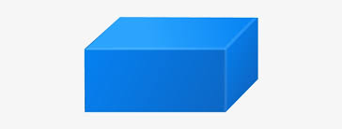

Slide 4
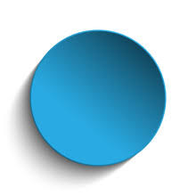
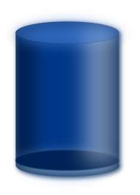

Slide 5
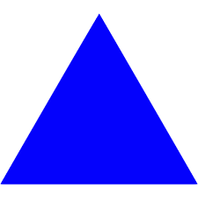
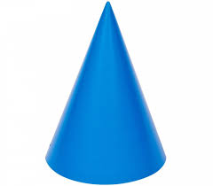

Slide 6

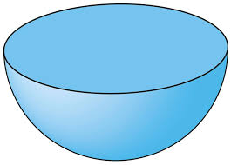

Slide 7
1. The ratio between the length and the breadth of a rectangular park is 3 : 2. If a man cycling along the boundary of the park at the speed of 12 km/hr completes one round in 8 minutes, then the area of the park (in sq. m) is:
15360
153600
30720
307200

Slide 8
2. The length of a rectangle is halved, while its breadth is tripled. What is the percentage change in area?
A. 25% increase
B. 50% increase
C. 50% decrease
D. 75% decrease
E. None of these

Slide 9
3. The edges of the cuboid are in the ratio 1:2:3 and its surface area is 88 cm . Volume of cuboid is ?
24 cu. cm
48 cu. cm
64 cu. cm
120 cu. cm

Slide 10
5. A rectangular park 60 m long and 40 m wide has two concrete crossroads running in the middle of the park and rest of the park has been used as a lawn. If the area of the lawn is 2109 sq. m, then what is the width of the road?
1
3
2
4

Slide 11
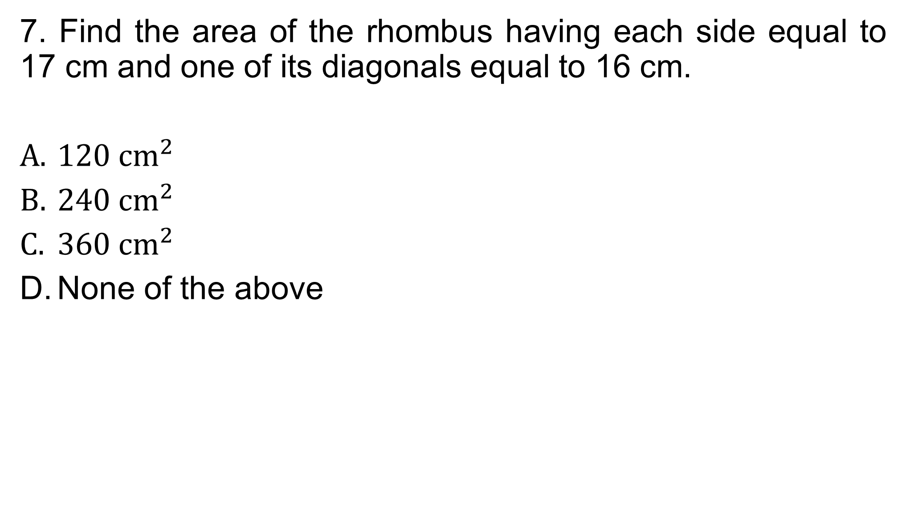
7. Find the area of the rhombus having each side equal to 17 cm and one of its diagonals equal to 16 cm.
120 $cm^{2}$
240 $cm^{2}$
360 $cm^{2}$
None of the above

Slide 12
8. The slant height of a right circular cone is 10 m and its height is 8 m, then the area of its curved surface is
A. 80πm2
B. 60πm2
C. 65πm2
D. 70πm2

Slide 13
9. A hemisphere and a cone have equal bases. If their height are also equal, then the ratio of their curve surfaces will be:

Slide 14
10. A tank is 25m long 12m wide and 6m deep. The cost of plastering its walls and bottom at 75 paise per sq m is
A) Rs. 258
B) Rs. 358
C) Rs. 458
D) Rs. 558

Slide 15
11. A cistern 6m long and 4m wide contains water up to a depth of 1.25m. The total area of the wet surface is:

Slide 16
12. The area of a rectangle is 460 square metres. If the length is 15% more than the breadth, what is the breadth of the rectangular field?
20 m
30 m
40 m
50 m

Slide 17
13. What will be the cost of building a fence around a square plot with area equal to 289 sq ft, if the price per foot of building the fence is Rs. 58 ?
Rs. 3748
Rs. 3847
Rs. 3944
Rs. 3866

Slide 18
14. The curved surface area of a cylinder is 264 m2 and its volume is 924 m3. Find the ratio of its diameter to its height.
6 : 7
7 : 6
3 : 7
7 : 3

Slide 19
15. The curved surface area of a cylinder is 4400 cm 2 and the circumference of its base is 110 cm. Find the height and the volume of the cylinder.
40 cm
50 cm
100 cm
80 cm

Slide 20
16. The radius of a metallic sphere is 7 cm . if it melted and mold in some cones of radius 7 cm and height of 4 cm , then how many cones will be produced
14
7
12
10

Slide 21
17. The diagonal of the floor of a rectangular closet is 7.5 feet. The shorter side of the closet is 4.5 feet. What is the area of the closet in square feet?
5
13
27
37

Slide 22
THANK YOU

